Slide 1
Bullying & Beyond: It’s a serious problem to be taken seriously..

Slide 2
Ryan’s Story
About – Ryan's Story Presentation

Slide 3
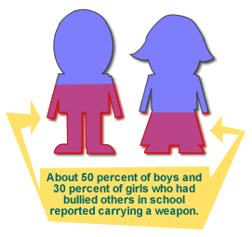
Bullying is a risk factor for future Violence…
Research has determined that children who bully and those who are bullied carry weapons to schools:
About 50 percent of boys and 30 percent of girls who had bullied others in school reported carrying a weapon.
Thirty-six percent of boys and 15 percent of girls who had been bullied carried a weapon.
Youth who are bullied and who also bully others away from school were nearly 16 times more likely to carry a weapon.

Slide 4
What is Bullying?
Teasing that has gone too far.
A form of harassment (physical, sexual, emotional).
Making someone feel uncomfortable and unsafe by using words, gestures and physical aggression.
Repeated physical, verbal, psychological, sexual attacks on another person.

Slide 5
How to stop the Bully
Request that the bully stop.
Seek immediate adult help if the bully does not stop.
Speak up and/or offer support to the victim (e.g., pick up his or her books, offer kind words).
Meet with your Guidance Counselor, tell a parent or a trusted adult.
Privately support those being hurt with kind words.
Take the bully aside and ask him or her to "cool it."
Disapprove of the bullying behavior by not joining in the laughter, teasing, or spreading rumors or gossip.

Slide 6
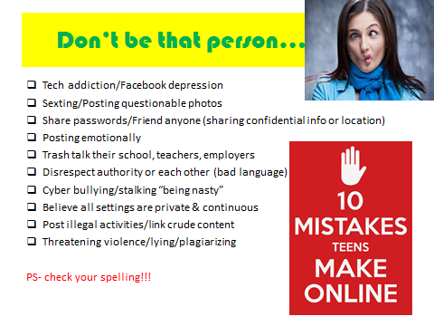
Online Bullying & Foolishness

Slide 7
Bullying has lasting consequences…
Youth who are bullied have higher rates of suicide, depression, post-traumatic stress disorder, and substance abuse.
Hostile kids who mistrust others are much more likely than their peers to develop physical symptoms linked to diabetes and heart attacks in the future.
Youth who bully others frequently behave badly in school and are more likely to smoke and drink alcohol.
According to the latest Secret Service Safe School Initiative, almost 75 percent of students who used violent weapons at school (e.g., guns or knives) to attack others felt persecuted, bullied, threatened, attacked, or injured by others prior to the incident
Six out of 10 kids identified as bullies in middle school are convicted of a crime by the time they reach age 24.
Years after experiencing bullying, adults who were bullied as teens have higher levels of depression and poorer self-esteem than other adults.
Children exposed to violence either at home or at school often suffer long-term problems such as anxiety, depression, post-traumatic stress, low self-esteem, anger, and self-destructive behaviors.

Slide 8
School shootings by location since 2013

Slide 9
School shootings in 2015 in US

Slide 10
The potential for school violence
Targeted violence: any incident of violence where a known or knowable attacker selects a particular target prior to a violent attack.
Incidents of targeted violence in schools rarely were impulsive acts.
Most attackers did not threaten their targets directly prior to the attack, but others might have known about the attack.
Most attackers felt bullied, persecuted or injured by others.
Most attackers had access to and had used weapons prior to the attack
Notes:
Provided by: Prior Knowledge of Potential School-Based Violence: Information students learn may prevent a targeted attack (United States Secret Service & US Dept. of Education, May 2008)

