Slide 1
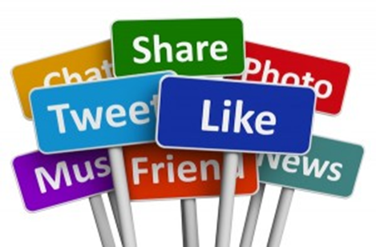
Balancing Self Respect & Integrity In a Social Media Society

Slide 2
The way we used to socialize
Then…
Now…

Slide 3
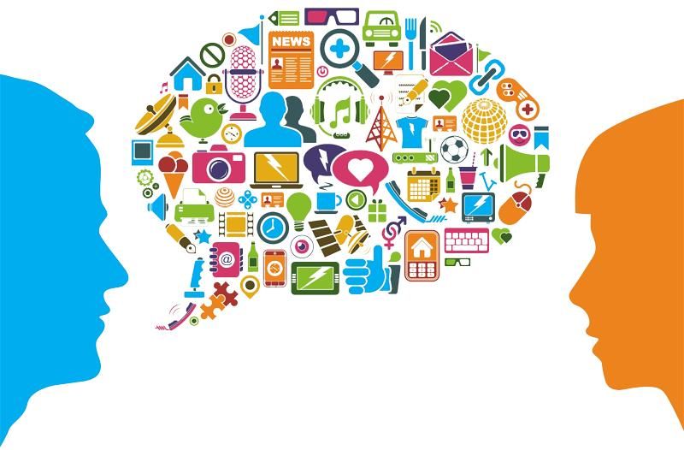
Communication
Self-image is important, and not always in a narcissistic way. It's how we define ourselves, and present for others to see. We rely on others' perceptions, judgments and appraisals to develop our social self. Emotional intelligence- ability to read your own and other people’s emotions
Perceiving emotion
Facilitating emotion
Understanding emotion
Managing emotion (self regulation)

Slide 4
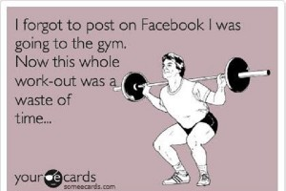
Non-verbal communication
Much of our communication is non-verbal. This is where problems lie in communicating by social media.
facial expressions/gestures
paralinguistic
body language/posture
proxemics/eye gaze
gestures
appearance/artifacts

Slide 5
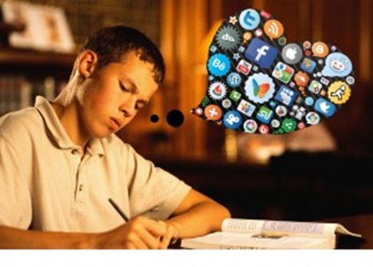
Are you communicating with integrity? (online and/or in person)
in·teg·ri·ty/inˈteɡrədē/
noun the quality of being honest and having strong moral principles; moral uprightness. the state of being whole and undivided.
in·teg·ri·ty/inˈteɡrədē/
Positive Negative
open mind gossip
appropriate comments/actions inappropriate comments/actions
sharing right amount of info sharing too much information
honesty/tact dishonesty
appropriate compliments/language sexually driven/inappropriate
Sharing info about another in private loud, obnoxious disclosure in public
Sharing positive news/opinions discriminatory comments (race, gender, Social media as a network/resource religion)
bad mouth current employer, co-workers, peers
post provocative pics of self or others

Slide 6
OMG!

Slide 7
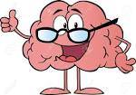
Research shows…
The frontal lobe of the human brain doesn’t develop fully until age 24. This area controls motor function, emotional expression, problem solving, impulses, language, judgment and sexual behavior.
Studies have shown that the comments on your Facebook profile picture strongly affect your level of perceived physical, social and professional attractiveness.
One of the differences between our self-image in real life and online is more ability to change our look, and also mask our identity. Even when a person posts a photo of you on social media, you can untag, delete or modify the photo to keep social presence more consistent with the self-image you want others to see.
Studies conducted on the negative effects of Facebook showed that users were likely to develop feelings of depression, loneliness, resentment and lowered self-esteem. Unsurprisingly, the most negatively charged aspects were those linked to photo sharing.

Slide 8
The ‘Looking Glass Self’
The opinion of others has been a part of identity development for more than a century. The "looking-glass self" is a psychological concept that suggests we develop our sense of self based on the perceptions of those we interact with, said Andrea Letamendi, a doctor of psychology at UCLA.
"Now that we can interact with hundreds — no, thousands — of people simultaneously, we've strengthened the impact that others have on our self-value," says Dr. Letamendi.
Studies have shown that the comments on your Facebook profile picture strongly affect your level of perceived physical, social and professional attractiveness.

Slide 9
Instagram
Instagram is imperatively filled with half-truths and optimizations of life, yet we still use it to gauge our own. For some reason, though, we don’t consider Instagram photos to be as manipulative of reality as the photos in magazines.
When all we can see of each other’s lives is whatever fits within perfectly filtered squares, we’ll inevitably do the kind of harmful self-assessment that keeps us thinking that the grass really is greener on the other side — that everyone else’s lives are more perfect than our own.

Slide 10
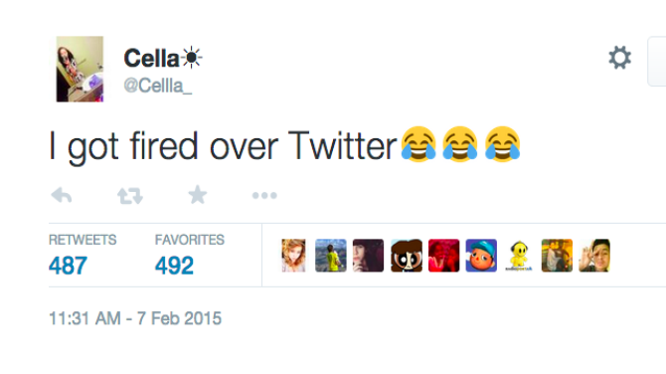
A 2014 survey of companies by CareerBuilder found that 43 percent of respondents said they screen potential job candidates by perusing profiles on social media sites in search of warning signs that a candidate might not be a good fit. Among the most common reasons cited for not hiring a candidate include:
posted provocative or inappropriate photographs or information (46 percent);
posted content about them drinking or using drugs (41 percent); bad-mouthed their previous employer, co-workers or clients (36 percent);
discriminatory comments related to race, gender, religion etc. (28 percent);
lied about qualifications (25 percent).

Slide 11
